Slide 1
SIGMA SQUAD
DCM
Dust Collecting Machine

Slide 2

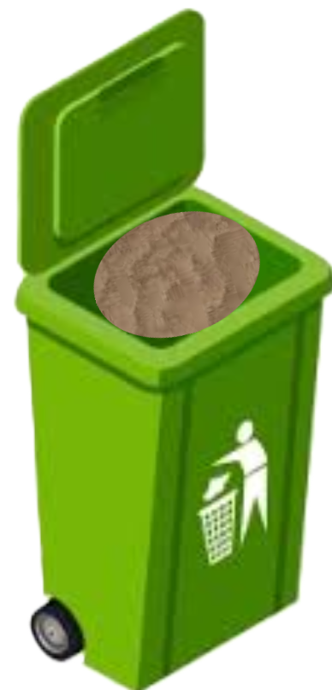
OBJECTIVES
1) CAPTURING THE DUST PARTICLES
2) COLLECTING THE CAPTURED DUST PARTICLES

Slide 3
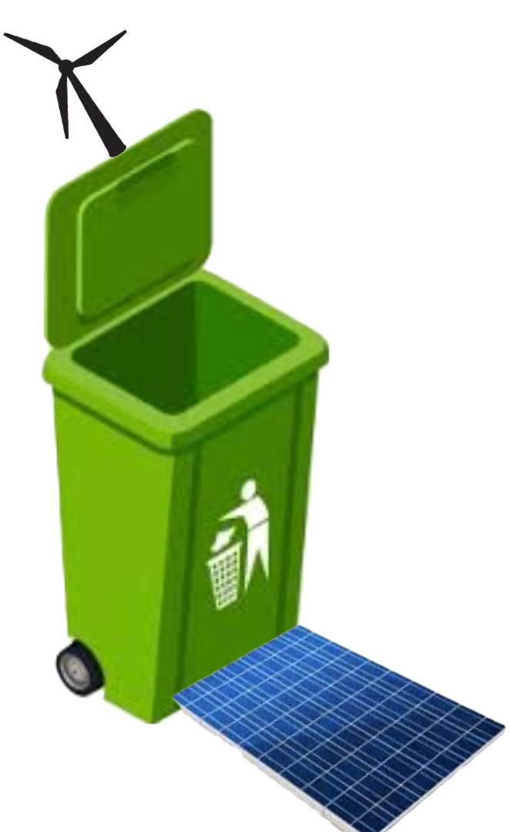
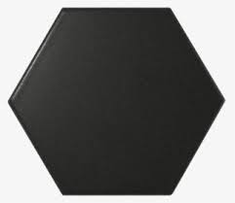

3) WORKING OF THIS DEVICE USING SOLAR (OR) WIND (OR) KINETIC ENERGY
4) CONVERSION OF WASTE INTO A USEFUL BY-PRODUCT

Slide 4
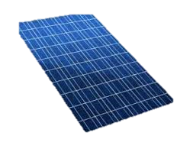

MECHANISMS USED IN THIS DEVICE
FOR ENERGY :
SOLAR ENERGY
WIND ENERGY
KINETIC ENERGY

Slide 5
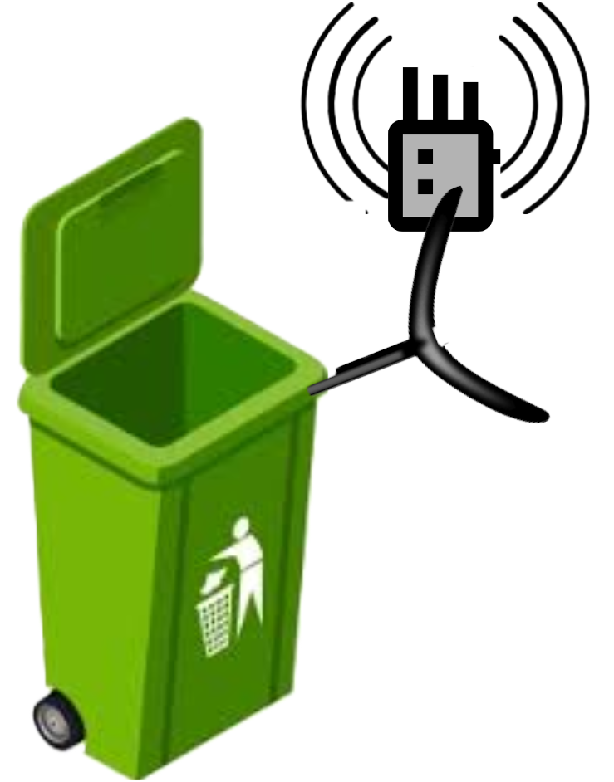
IN ORDER TO KEEP BIRDS AND INSECTS AWAY FROM THE DEVICE, A WAVE OF SUITABLE WAVELENGTH AND FREQUENCY IS PASSED AROUND THE DEVICE.
METHODS SUCH AS MAGNETIC SEPARATION IS IMPLEMENTED IN THE PROCESS TO SEPARATE PARTICLES OTHER THAN DUST (for example: IRON, GLASS etc.).

Slide 6
BRUSHLESS MOTOR IS USED IN ORDER TO REDUCE THE NOISE CREATED DURING SUCTION OF DUST PARTICLES

Slide 7




MOTTO OF THIS DEVICE
TO REDUCE AIR POLLUTION AND ACT AS DUST MANAGEMENT DEVICE
REDUCE RESPIRATORY DISEASES SUCH AS ASTHMA, SKIN INFECTIONS,EYE INFECTIONS WHICH ARE CAUSED BY AIR POLLUTANTS.

Slide 8

TO REDUCE CARBON EMISSIONS FROM EXTERNAL FACTORS
GAINED BY-PRODUCTS CAN BE USEFUL TO CREATE UTILIZABLE PRODUCTS, THEREBY FOLLOWING RECYCLE PRINCIPLE
SINCE, IT WORKS ON RENEWABLE ENERGY SOURCES, ENERGY CAN BE GENERATED FOR THE DEVICE INFINITELY AND IT DOES NO HARM TO THE ENVIRONMENT.

